Slide 1
Lab Animal Safety: Part 1: Zoonosis and Infectious agents Part 2: Allergy Prevention
Alyssa McIntyre, DVM, DACLAM

Slide 2
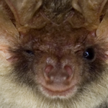
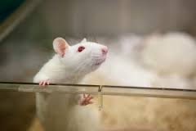
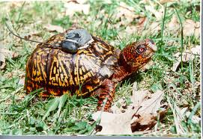
Zoonosis and Allergy Prevention
The focus of these presentations are to understand:
The transmission of disease between humans and animals
Types of disease
The causes, treatment, and prevention of allergies

Slide 3
Part 1: Introduction to Zoonosis and other Infectious agents
Zoonosis
Types of zoonotic diseases
Transmission
How to prevent the spread of zoonotic diseases
Infectious Agents in the Field

Slide 4
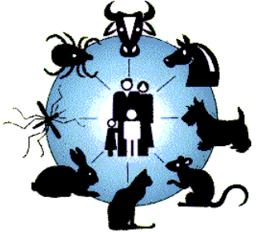
What Is Zoonosis?
Zoonosis is a contagious disease spread from:
animal to human
The term “reverse zoonosis” has been used to describe a disease transmissible from:
human to animal

Slide 5
Zoonotic infection types:
Infections transmitted directly from animals to humans
Vector-borne infections in which an animal or human is infected by the vector
Infections in which animals act as a reservoir for disease transmission, including having the potential for contaminating human food and water sources

Slide 6
How can a zoonotic or infectious disease be transmitted?
Airborne
Fecal-oral
Direct contact
Foodborne
Arthropod Vector

Slide 7
Zoonosis and Research
Strong potential for animals to infect humans
Disrupts research if animals contract infections from humans
Examples?
~ 75% of recently emerging infectious diseases affecting humans are diseases of animal origin
~ 60% of all human pathogens are zoonotic or “reverse zoonotic”

Slide 8
Zoonotic and Infectious Agents
Virus’
Bacteria
Parasite/Protozoa
Fungi
Rickettsia
Helminthes
Zoonotic disease and infectious agents are associated with all lab and field animals!!!

Slide 9
Viral Diseases
Lymphocytic Choriomeningitis Virus (LCMV)
Rabies
Hepatitis A, B, C, D, and E
Others:
Measles (Rubeola)
Influenza

Slide 10
Viral Diseases: What/Who can be infected?
 | Dogs | Bats | Rodents | Humans
Rabies | X | X | X | X
Lymphocytic Choriomeningitis virus |  |  | X (Hamsters!) | X
Hepatitis | X | X | X | X
Others:
Non-Human Primates: transmit Fatal Herpes B to humans, measles
Ferrets: Susceptible to human influenza

Slide 11
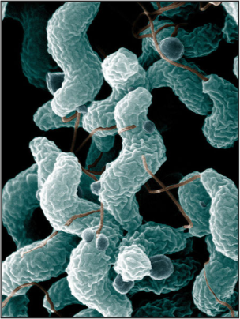
Bacterial Diseases
Tetanus
E. coli
Rat-Bite Fever
Leptospirosis
Campylobacteriosis
Tularemia
A mixture of Zoonotic agents and other agents that might be found in the field/water/non-vendor animals
Notes:
Rat bite fever- (Sterptobacillus moniliformis) not present in research rodents form major vendors like CRL; present in wild populations of rats
TB- human & NHPs frequently infected, our NHPs are tested at least twice yearly
Lepto- can be transmitted to any dog when exposed to the infection
Campy, salm, shigella– present in our NHPs

Slide 12
Bacterial Diseases
 | Dog | Rodent | Human | Field Exposure- no animal contact needed
Tetanus | X |  | X | X
E. Coli (colibacilosis) | X | X | X | X
Rat Bite Fever |  | X | X
Leptospirosis | X |  | X | X
Campylobacteriosis |  |  |  | X
Tularemia |  | X | X | X
Salmonella |  |  | X | Turtles, frogs
Notes:
http://www.cdc.gov/salmonella/general/prevention.html
http://www.mayoclinic.org/diseases-conditions/e-coli/basics/prevention/con-20032105
http://www.cdc.gov/leptospirosis/
http://www.cdc.gov/nczved/divisions/dfbmd/diseases/campylobacter/#how_infect
http://www.cdc.gov/rat-bite-fever/
http://www.cdc.gov/vaccines/vpd-vac/tetanus/default.htm
http://www.cdc.gov/tularemia/transmission/index.html

Slide 13
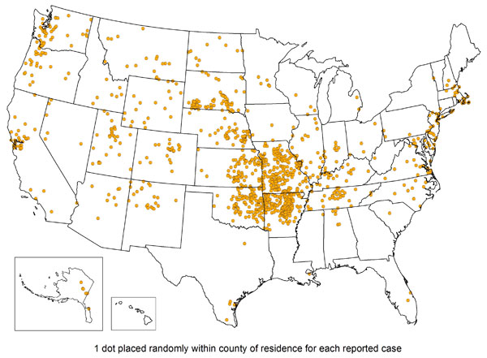
Tularemia
Tularemia is a disease of animals and humans caused by the bacterium Francisella tularensis
Rabbits, hares, and rodents are especially susceptible and often die in large numbers during outbreaks.
Humans can become infected through several routes, including:
Tick and deer fly bites
Skin contact with infected animals
Ingestion of contaminated water
Inhalation of contaminated dusts or aerosols
Notes:
http://www.cdc.gov/tularemia/

Slide 14
Bacterial Disease from the field: Non-zoonotic
Tetanus?
Wounds contaminated with dirt, feces, or saliva
Wounds caused by an object puncturing the skin, like a nail or needle (puncture wounds)
Burns

Slide 15
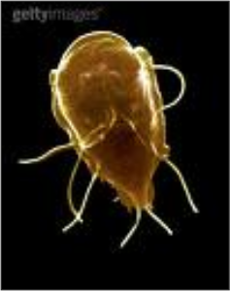
Parasitic and Protozoal Diseases
Giardiasis
Cryptosporidiosis
Amebiasis
Balantidiasis
Toxoplasmosis*
*Toxoplasmosis is most common in cats (kittens) and New World NHP’s, not covered

Slide 16
Parasitic and Protozoal Diseases
 | Dogs | Rodents | Humans | Possible Exposure in field- no animal contact needed
Giardia | X | X | X | X
Cryptosporidia (parasite) | X |  | X | X
Ameba | X |  | X | X
Balantidium | X |  | X
Notes:
http://www.cdc.gov/parasites/crypto/
http://www.cdc.gov/dpdx/freeLivingAmebic/
http://www.cdc.gov/healthywater/burden/current-data.html
http://www.cdc.gov/parasites/balantidium/

Slide 17
Fungal Diseases
Dermatomycosis
“Ringworm”
Trichophyton mentagrophytes
mainly in rodents and mice
Microsporum canis
mainly in dogs and cats
Commonly transmitted FROM humans TO dogs, cats and rodents

Slide 18
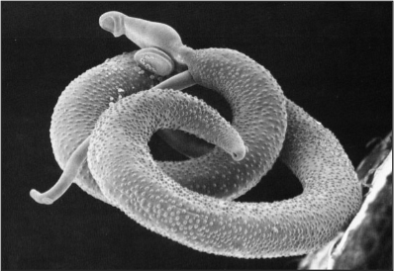
Helminth Infections
Roundworm
Hookworm
Whipworm
Common in pets and wild animals
Spread by fecal-oral transmission
Persist in Soil, transmissible without direct animal contact
Notes:
The pinworms seen in Lafayette in 2007 were not transmissible to humans
Visceral larval migrans
Ocular larval migrans
Trichuriasis

Slide 19
Arthropods
All rodents are negative at commercial vendors but can be infested during transit, or on site
Potential “reverse zoonosis”
Found on Rats and Mice:
Fleas, mites/scabies, lice
Found on Cats and Dogs:
Fleas, mites/scabies, mange, ticks, lice
Found in the Field:
Ticks!
Mosquitos!

Slide 20
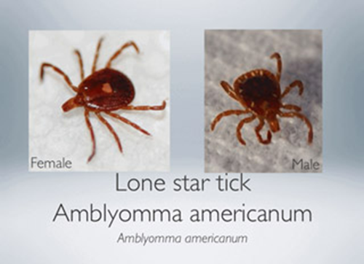
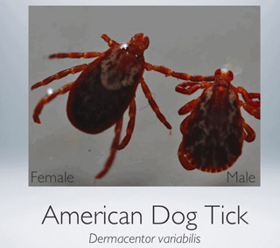
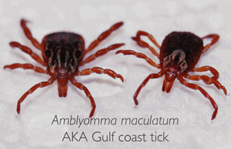
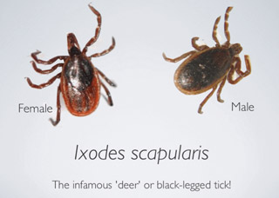
Ticks in North Carolina

Slide 21
Tick-Borne Illness: Rickettsial Diseases
Lone Star tick:
Transmits ehrlichiosis, Southern Lyme (STARI), tularemia, tick paralysis, and possibly Tularemia, Lyme disease and Babesiosis in NC
American Dog Tick:
Transmits Rocky Mountain Spotted Fever, tick paralysis, tularemia, and possibly ehrlichiosis
Deer Tick or Black-legged Tick:
Transmits Lyme disease, babesiosis, erhlichiosis, bartonella, and possibly Powassan encephalitis and tick-borne encephalitis (viral)

Slide 22
Tick-Borne Illness: West Nile
Most people are infected between June-September
The most effective way to avoid West Nile virus disease is to prevent mosquito bites:
Use insect repellents when you go outdoors. Repellents containing DEET, picaridin, IR3535, and some oil of lemon eucalyptus and para-menthane-diol products provide longer-lasting protection.
Wear long sleeves and pants from dusk through dawn when many mosquitoes are most active
Notes:
http://www.cdc.gov/westnile/transmission/

Slide 23
Tick Tips:
If you remove an attached tick
Save it in a vial of alcohol in the freezer
Write down the date and location (on your body) where it was removed
http://www.tic-nc.org/aboutticks.html

Slide 24
Diarrhea caused by Zoonotic agents
Salmonella
Outbreaks ~ associated with foods
Commonly found in turtles, iguanas, other lizards, snakes (asymptomatic carriers)
Avoid direct or even indirect contact between reptiles and infants or immunocompromised persons
Wash hands with soap after handling reptiles, birds, or baby chicks, and after contact with pet feces
Notes:
CDC updates the Division of Parasitic Disease website regularly– discusses food borne illness
CDC update Division of parasitic diseases: Diarrhea caused by an infection may result from:
Parasites (e.g., Cryptosporidium, Cyclospora, Entamoeba, Giardia, Cryptoisospora, microsporidia)
Bacteria toxins (e.g., Campylobacter, Clostridium difficile, E. coli, Salmonella, Shigella, cholera)
Viruses (e.g., norovirus, rotavirus)

Slide 25
Diarrhea Caused by Zoonotic agents
Campylobacter
Common bacterial cause of diarrhea in the United States
Most cases occur as isolated, sporadic events, not as part of recognized outbreaks
Campylobacter jejuni grows best at 37°C to 42°C, the approximate body temperature of a bird and seems to be well adapted to birds (asymptomatic carriers

Slide 26
Diarrhea Caused by Zoonotic agents
E. coli
Escherichia coli (E. coli) bacteria normally live in the intestines of people and animals.
Most E. coli are harmless and actually are an important part of a healthy human intestinal tract. However, some E. coli are pathogenic, meaning they can cause illness
The types of E. coli that can cause diarrhea can be transmitted through contaminated water or food, or through contact with animals or persons.
People have gotten infected by swallowing lake water while swimming, touching the environment in petting zoos and other animal exhibits

Slide 27
Diarrhea Caused by Zoonotic agents
Giardia
Most common non-bacterial cause of diarrhea in the United States
Most commonly transmitted via contaminated water
Foodborne illness/infection is the most common cause of diarrhea reported to CDC
The agents causing the infection may originate from animals or humans
These same agents may also be present in feces of research animals in field studies and research primates

Slide 28
Questions:
Do our vivarium animals have any of these zoonotic pathogens?
Do Field research animals have any of these pathogens?
Does North Carolina have any of these pathogens in fields, streams, or woods?

Slide 29
Animals from Vendors
Normal gastrointestinal flora may include pathogenic organisms
Animals can be infected if humans bring the infective larvae into the facility on shoes or clothes

Slide 30
Animals from Reputable Vendors…
Rodents arrive without arthropod infestations, but can easily be infested if humans bring them into the facility
Humans can transmit diseases to lab animals
Bacteria and fungi can be transmitted between animals and humans if proper PPE and personal hygiene practices are not followed

Slide 31
Prevention: In the animal facility
Controlled access to animal areas
Mandatory Personal Protective Equipment (PPE)
Air pressure in animal rooms in maintained negative relative to the clean area
Personal Hygiene – Hand washing!
Notes:
Lafayette airflow is different-

Slide 32
Personal Protective Equipment
PPE helps protect you from exposure to zoonotic disease
Dedicated facility clothing
Long sleeve lab coat
Gloves
Safety glasses
Shoe covers
PPE also protects the animals from humans who might be spreading zoonotic agents (reverse zoonosis)

Slide 33
Prevention: In the Field
Field-specific Awareness and Education!
Vaccination when possible (e.g. Rabies, Tetanus)
Potable water
Mosquito and Tick bite prevention
Hand-washing / sanitizer
Limit exposure to infected species and fecal material

Slide 34
Zoonosis and other infectious agents summary:
Animals can give diseases to You
You can give diseases to Animals
Minimize your exposure to animal waste in the facility and in the field
Be safety conscious when handling any animal
Be safety conscious in the field: Mosquitos, ticks, water, soil, and even edible berries can carry infectious disease

Slide 36
Laboratory Animal Allergies
Objectives:
Are you likely to become allergic to lab animals?
Allergens and exposure
Diseases caused by Animal Allergens
Causes and Prevention

Slide 37
Lab Animal Allergies (LAA)
Significant occupational hazard!
Approximately 2 million workers have jobs that require contact with animals or animal products
Estimated prevalence of animal allergies in workers ranges from 21% to 35%

Slide 38
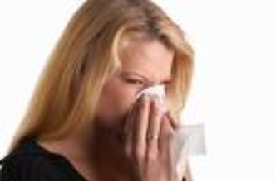
Routes of Exposure to Allergens
Inhalation of airborne allergens
Most common form of exposure
Skin contact
Eye contact
Ingestion
Via inhalation

Slide 39
Risk Factors
Existing Allergy to pets or other species
Intensity / duration of animal allergen exposure
Airborne contamination
Skin/eye contact
Secondhand from co-workers
Brought home on clothing
Allergies to other things, including hay fever, allergic skin rashes, allergic asthma, food allergies
Notes:
Atopy (atopic syndrome) is a syndrome characterized by a tendency to be “hyperallergic”. A person with atopy typically presents with one or more of the following: eczema (atopic dermatitis), allergic rhinitis (hay fever), allergic conjunctivitis, or allergic asthma. Patients with atopy also have a tendency to have food allergies.
Patients with atopy usually develop what is referred to as the “allergic triad” of symptoms, i.e., eczema (atopic dermatitis), hay fever (allergic rhinitis), and allergy-induced asthma (allergic asthma). They also have a tendency to have food allergies, and other symptoms characterized by their hyperallergic state. For example, eosinophilic esophagitis is found associated with atopic allergies.
Atopic syndrome can be fatal for those who experience serious allergic reactions, such as anaphylaxis, brought on by reactions to food or environment

Slide 40
Animal Allergens
Endotoxin
Serum
Pet
Dander
Allergens
Fur
Urine
and
Saliva
Scales

Slide 41
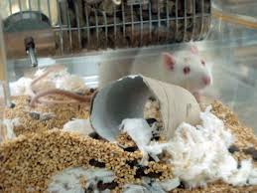
Human exposure to allergens is directly related to the normal activities of an animal:
In this picture, what are the potential allergens?
#1: Urinary Proteins
AND
Dander/hair
Bedding
Food dust

Slide 42
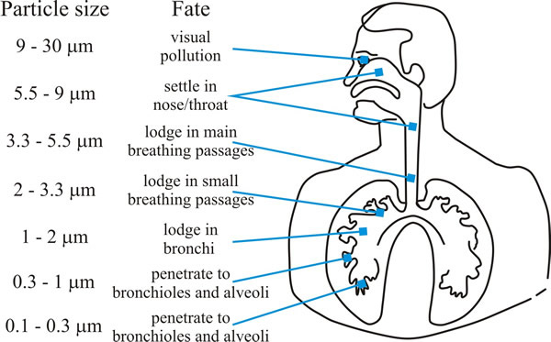
But the room doesn’t smell bad- Respiratory exposure?
Nanogram concentrations can elicit symptoms (ppb)

Slide 43
Types of Allergens
Animal Proteins (allergens)
saliva
dander (flakes of skin)
urine
Allergic reactions may also be triggered by:
Foods
Latex
Molds
Pollens
Insect stings

Slide 44
Medical Surveillance Programs
Identify workers with or at higher risk for LAA
Identify new cases of LAA or allergies to new species
Yearly assessment typical
Employees can report new symptoms anytime during the year

Slide 45
Allergic Reactions “Hypersensitivity Reactions”
Definition: excessive, undesirable (damaging, discomfort-producing and sometimes fatal) reactions produced by the normal immune system
Require a pre-sensitized host
Can be divided into four types based on mechanisms involved and reaction time:
Immediate Phase Reaction: Type I
Late Phase Reaction: Type II, III and IV

Slide 46
Hypersensitivity Reaction Overview
Immediate Reaction “Type I”
15-20 minutes
Called “atopic allergy”
Examples: asthma, hay fever, hives
Most common type of animal-associated allergy
Late Reaction “Type II”
Minutes to hours
Type III
3-8 hours
Type IV
48-72 hours
T cell mediated

Slide 47
Type I or Immediate Hypersensitivity
Symptoms:
Itching
Sneezing
Watery discharge
Congestion
Conjunctivitis
Asthma
Urticaria
Anaphylaxis

Slide 48
Type II, III, or VI Hypersensitivity
Symptoms:
Contact dermatitis (like poison ivy)
Skin erythema
Anemia
Less commonly associated with LAA

Slide 49
Allergy Onset Statistics
Most people who will develop LAA will do so within the first 3 years of employment
~ 1/3 of people will become symptomatic within the first year, 70% within the next 3 years
~ 30% of people who develop allergies will develop asthma
~ 70% who will develop asthma associated with LAA will do so within 3 years of developing the initial allergy
People who already have allergies are more likely to develop LAA
Notes:
review

Slide 50
Treatment and Prevention of Lab Animal Allergies
Early intervention
Tell your doctor or Health services as soon as you notice
Appropriate precautions
Wear PPE at work
Don’t take allergens home on street clothes
Avoid allergens- home or workplace
Allergy prevention is better than any allergy treatment!

Slide 51
NIOSH Recommendations
National Institute for Occupational Safety and Health comments regarding safety and prevention of allergies
Avoid wearing street clothes while working
leave work clothes at the workplace to avoid exposing family members / roommates
Keep all cages and work areas clean!

Slide 52
NIOSH Recommendations
Preventative measures include:
Animal handlers should take steps to protect themselves from exposure to animals and animal products
Reduce skin contact and inhalation by wearing PPE
Perform animal manipulations within ventilated hoods when possible and use HEPA ventilated cages and work spaces

Slide 53
Work Practices and Prevention
Education and training programs
Personal Protective Equipment
Dedicated labcoats and disposable PPE are provided to minimize contact with allergens
WEAR YOUR PPE !!!

Slide 54
Allergen containment
Air pressure in animal rooms is maintained negative relative to the corridor only when the door is closed
When the doors are held open for more than a few seconds, airflow equalizes and air (and airborne allergens) backflow into the corridor

Slide 55
References
"Laboratory Animal Allergy." Animal Care and Use in Research and Education. www.aalaslearninglibrary.org. AALAS Learning Library. <http://www.aalaslearninglibrary.org>.
Beatty, Robert. "Hypersensitivity." Microbiology. Berkeley College. <http://http://mcb.berkeley.edu/courses/mcb150/Lecture20/Lecture20(6).pdf>.
BioReliance<http://www.bioreliance.com>.
CDC-Centers for Disease Control and Prevention. <http://www.cdc.gov>.
Lane, Terry. "Animal Allergens & Endotoxins." Merck. 20 May 2009 <www.merck.com>.

Slide 56
References
Lowrie, Jonathan, and Reid Boswell. "Laboratory Animal Allergies." SoCal Tri Branch Symposium .University of California, LA. “
National Institute of Occupational Safety and Health. <http://cdc.gov/niosh >.

